Slide 1

DSS (Digital Streaming System)
A medium for admins to manage the movie catalogue

Slide 2
Dss(Digital Streaming System) A medium for the database admin to manage the database
By:
Melandro L. Richardson Jr

Slide 3
Project Abstract
DSS system is a Digital Streaming System which allows administrators to manage the movie catalogue view relevant information about the movies, actors and movie reviews (like Netflix or Amazon Prime).
This application stores details of movies, actors and movie reviews.

Slide 4
Project Goals
Prove the application of concepts learnt and practice by applying to a project as a team.
Understand requirements, visualize them using UML diagrams, develop the requirements and verify them by testing.
Use distributed version control system for developing the project as a team.
Apply various libraries, frameworks and tools.
Create a simple working prototype, and follow an iterative fashion to make the prototype better and apply best practices.
Implement a loosely-coupled, highly reusable code and integrate all the modules developed from day 1 of the training.
Develop the project in parallel with the sessions.
Explore the docs and observe different patterns in code.
Integrate the code written by the members of the team.

Slide 5
Design & Understanding Requirements
allow administrators perform:
A. Login and authentication.
B. Saving details of movies, viewing, updating and deleting them.
C. Saving details of actors, viewing, updating and deleting them.
D. Searching for movies and displaying their details.
E. View and add movie reviews given by film critics.
F. New administrators to register.

Slide 6
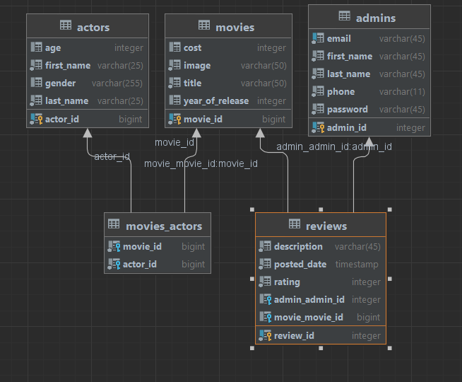
Entity Relationship Diagram

Slide 7
Architecture : High Level

Slide 8
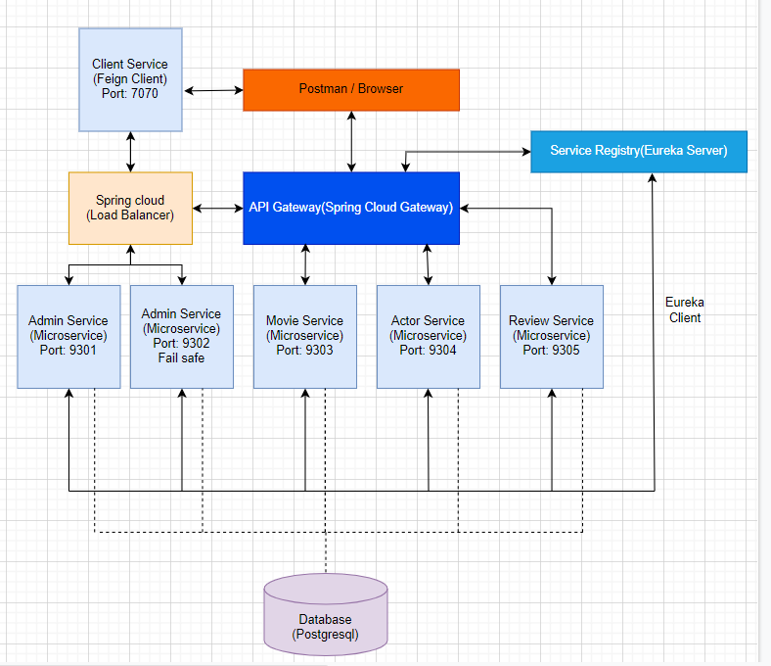
Architecture : High Level

Slide 9
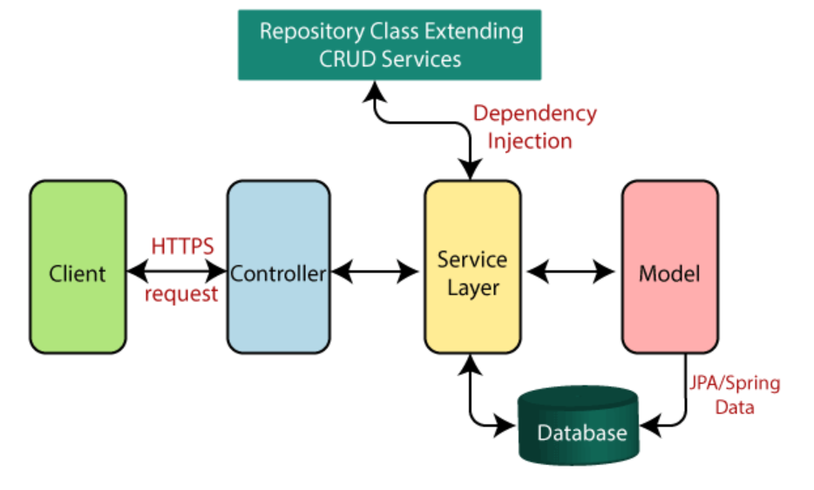
Layered Architecture
UI Layer
Controller layer
service layer
Repo layer

Slide 10
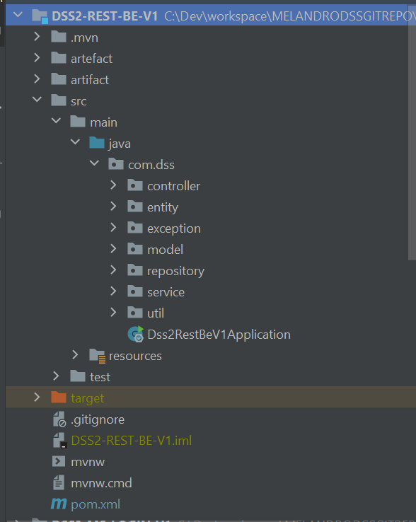
Layered Architecture implemented with Maven.
3 different repositories
Presentation layer - Controller
Service Layer - Service
Database Layer - Repository

Slide 11
Unit Testing
Testing (Junit)
CODE COVERAGE (Jacoco)

Slide 12
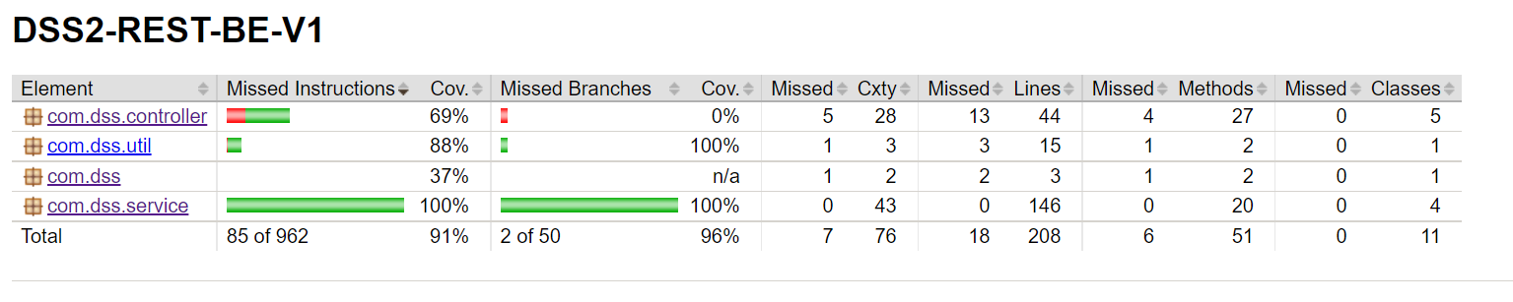
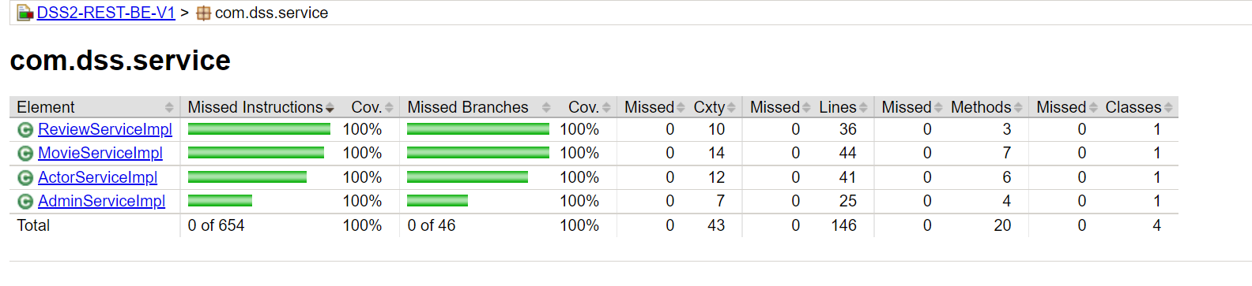
Testing with JUNIT5
Testing
Code Coverage

Slide 13
Testing REST API
Postman

Slide 14
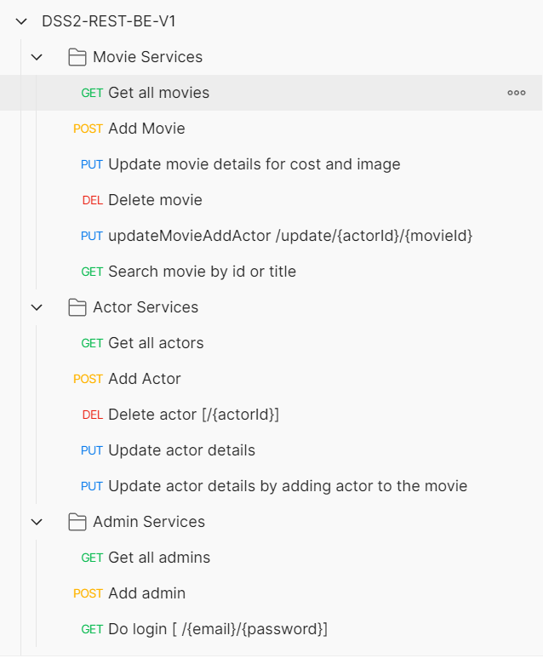
Postman

Slide 15
Frameworks
Spring & spring boot
Hibernate
Junit

Slide 16
Code Snippets
Microservices

Slide 17
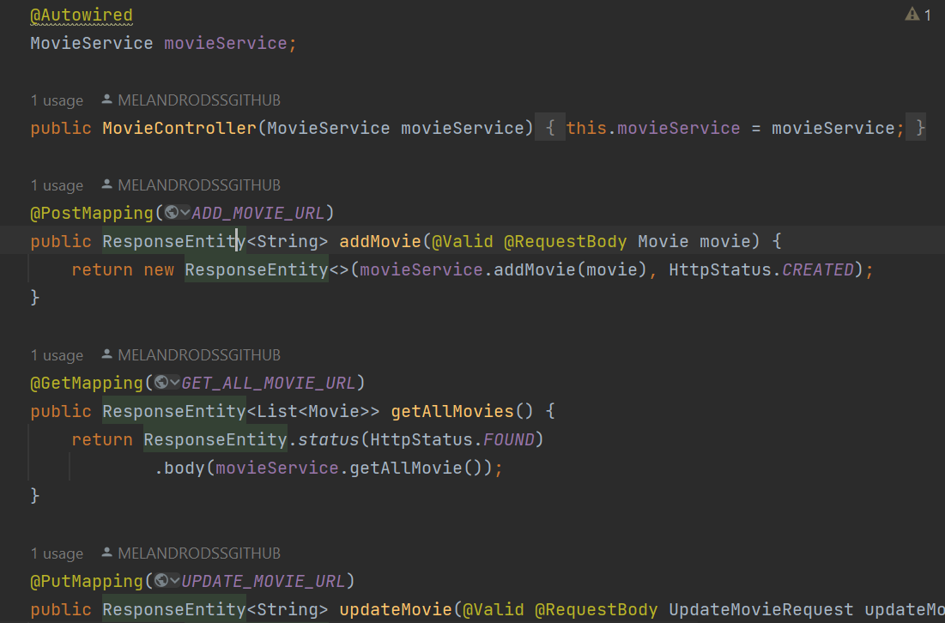
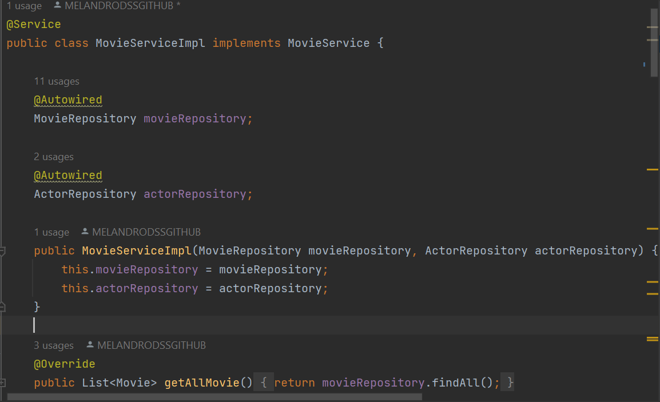
Code Snippets

Slide 18
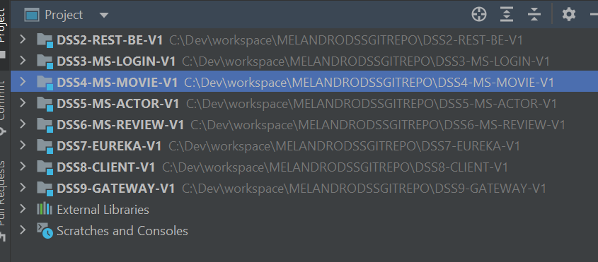
Modular Projects
Monolith
Microservices Project

Slide 19
Git & GITHUB

Slide 20
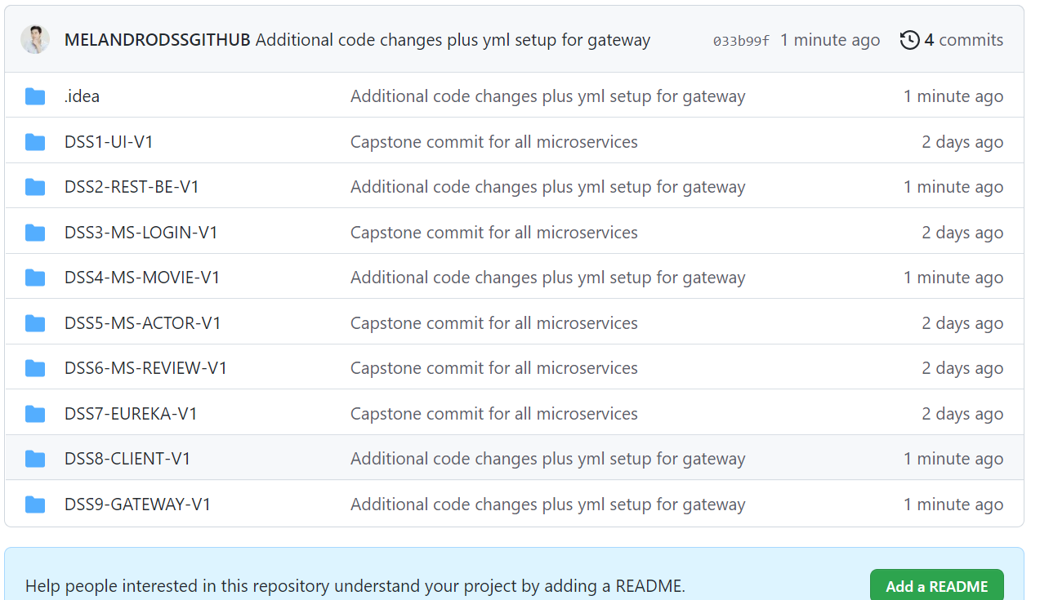
Screen shots

Slide 21
SOFTWARE CRAFTSMANSHIP
MAKING software designs THAT ARE
more understandable,
- flexible,
and maintainable.

Slide 22
Learning & Experiences
-Microservices & layered architecture
-Testing, modular development - SpRING BOOT APPLICATION
- JAVA 8

Slide 23
Thank you!

Slide 24
EXTRA FOR REFERENCE

Slide 25
DSS- Overview
Registered user
New user?
Login
Register
Authenticated Admin
Movies Catalogue
Actors Catalogue
Reviews Catalogue
C R U D & Search operations
C R U D & Search operations
C R U D & Search operations

Slide 26
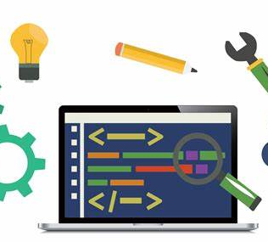
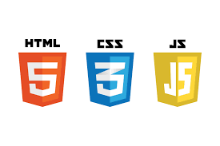





Development tools

Slide 27
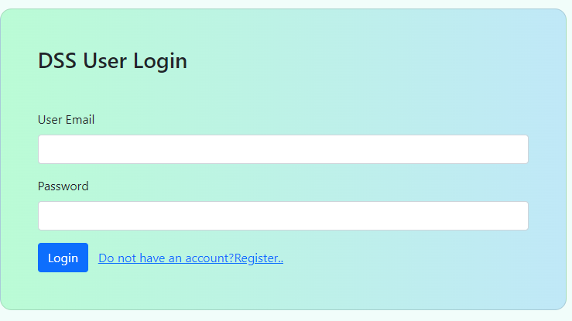
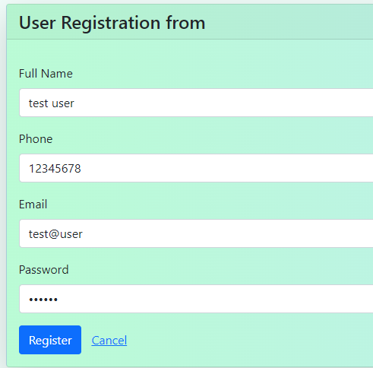
Forms are designed using bootstrap 5.1.3 and validated using angular & REST API
Login & Registration

Slide 28
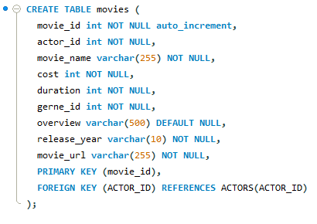
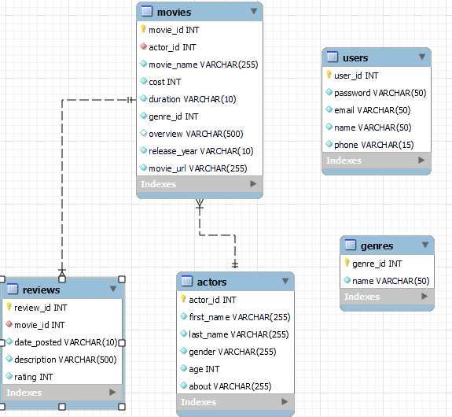
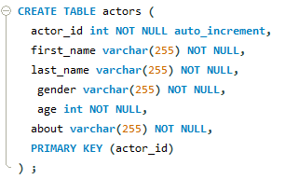
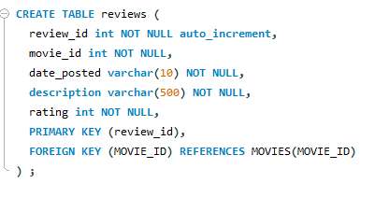
MySql Database Table design

Slide 29
Capstone Backend

Slide 30
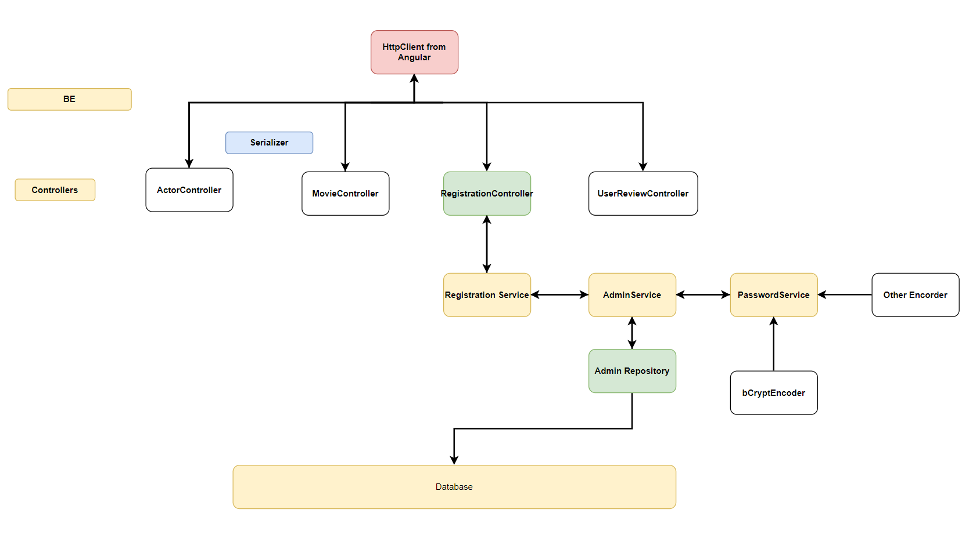
Backend Registration Controller
Notes:
Utility services connects and passing data between two components

Slide 31
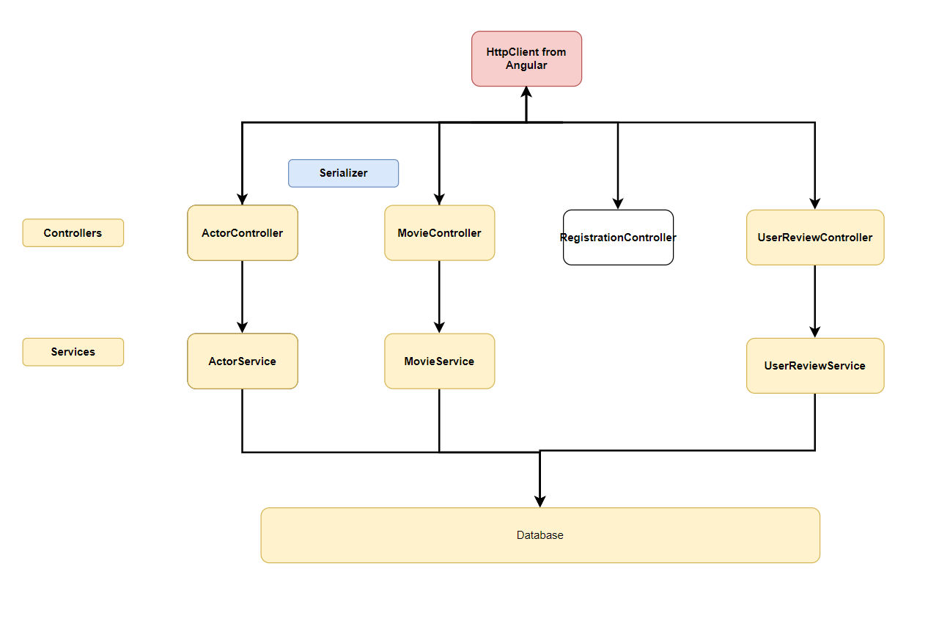
Backend Remaining Controllers
Notes:
Utility services connects and passing data between two components

Slide 32
Objective
Learn by doing: To get hands on experience in Full Stack Technology
Technologies used:
Springboot
Java 8
Postgre
JPA framework (Hibernate)
Angular 7
Node
Mongo
Express
Version Control Tool: Git
Build Tool: Maven and Jerkin
Application: To create a maker- checker application which can be used in multiple scenarios
Makers create their own account by registering with the required details
Requests are either accepted/ rejected by the maker

Slide 33
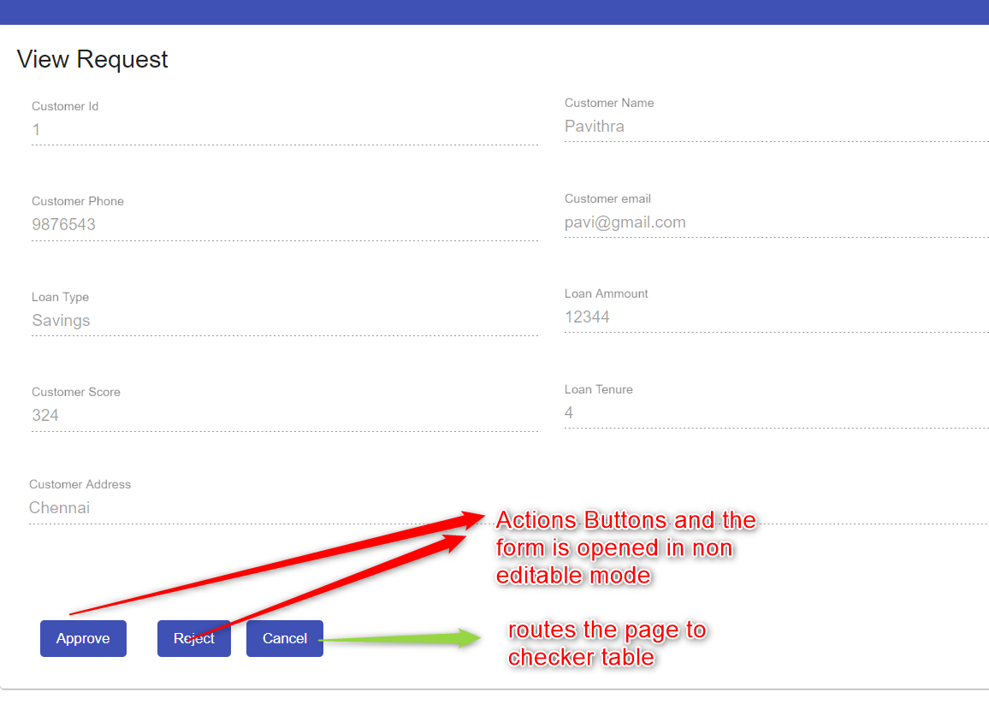
Screenshots
Checker Actions

Slide 34
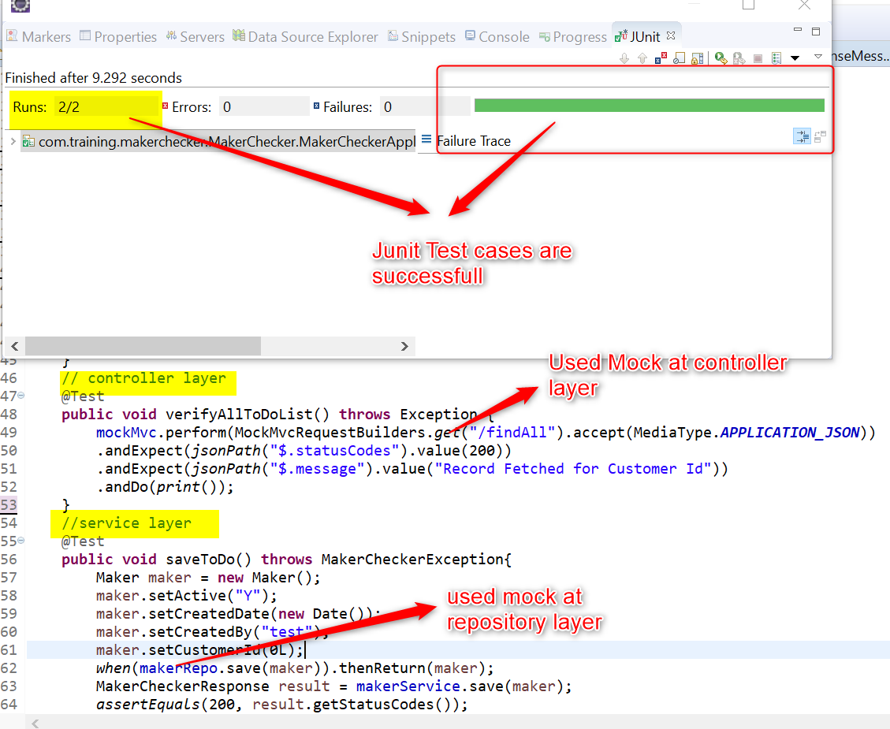
Screenshots
Junit Testcase

Slide 35
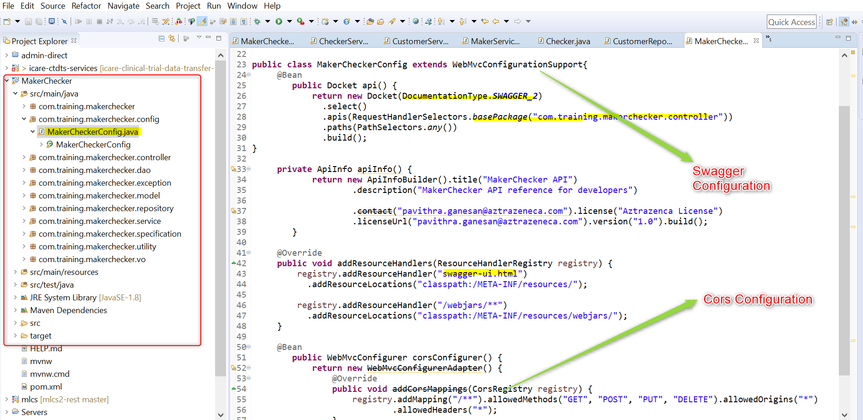
Code Snippets
Swagger & Cors Configuration

Slide 36
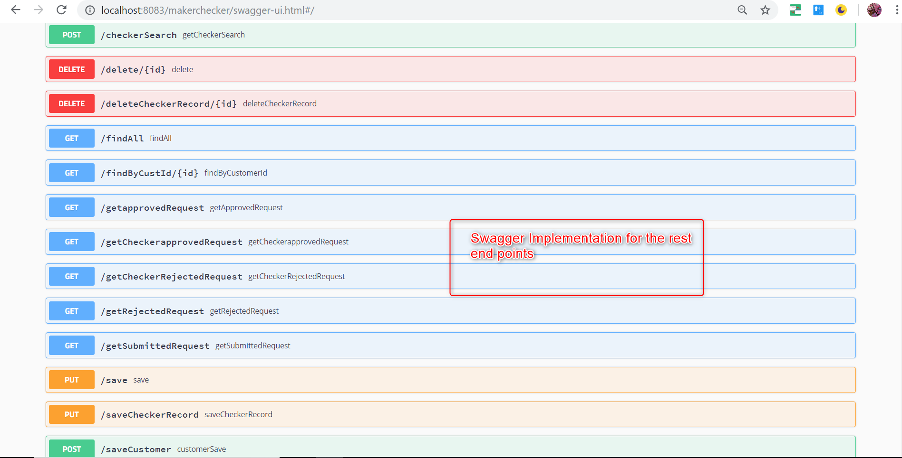
Code Snippets
Swagger UI

Slide 37
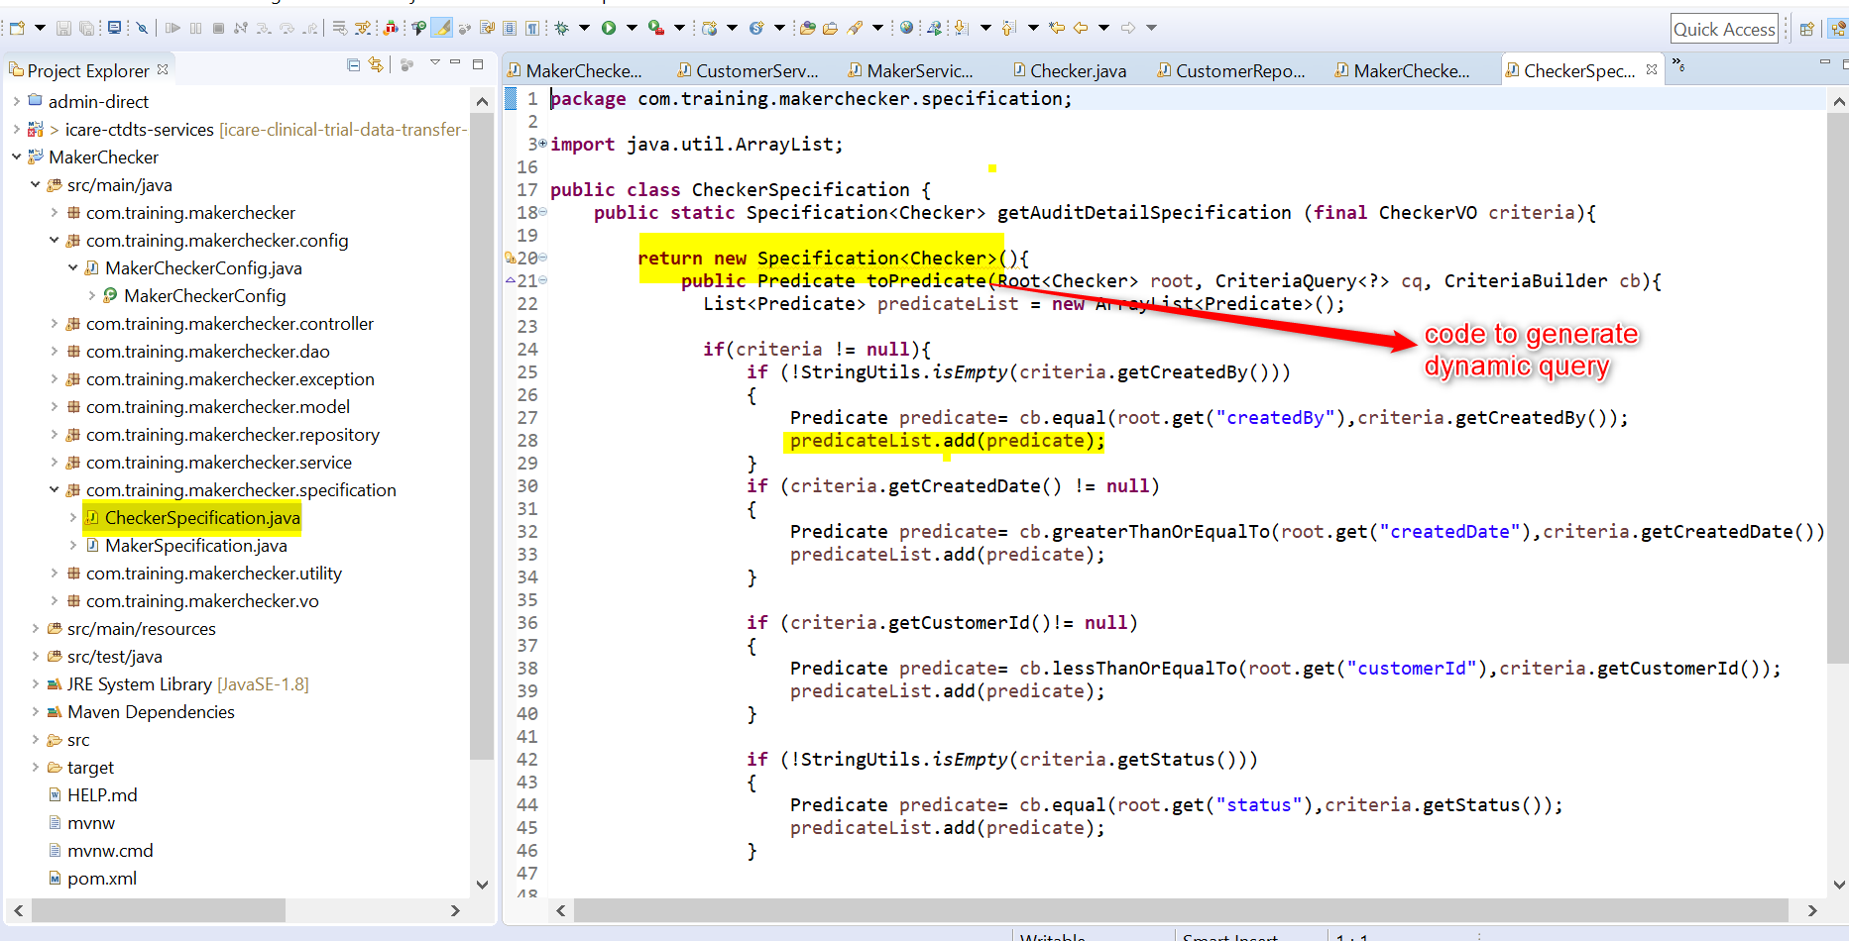
Code Snippets
JPA Specification

Slide 38
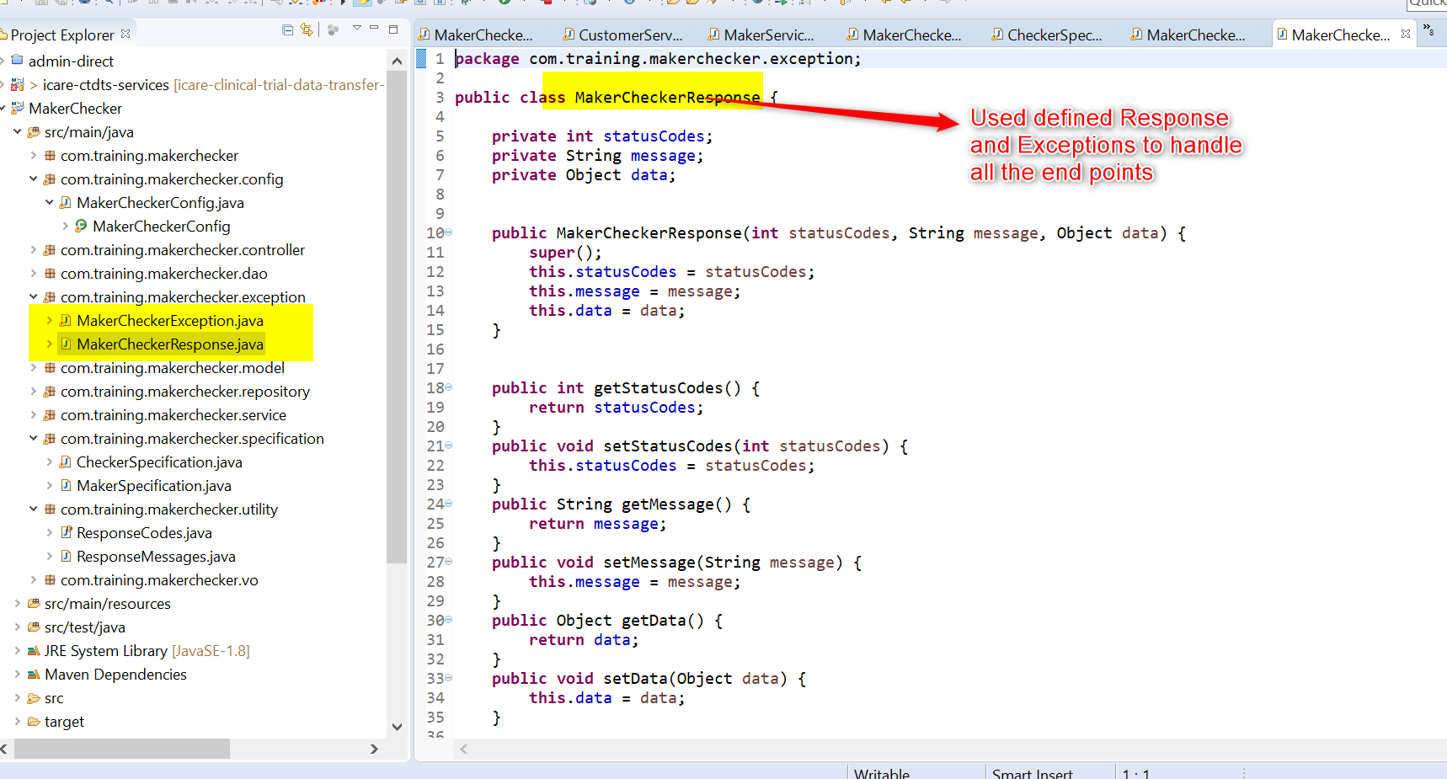
Code Snippets
User Defined Exceptions

Slide 39
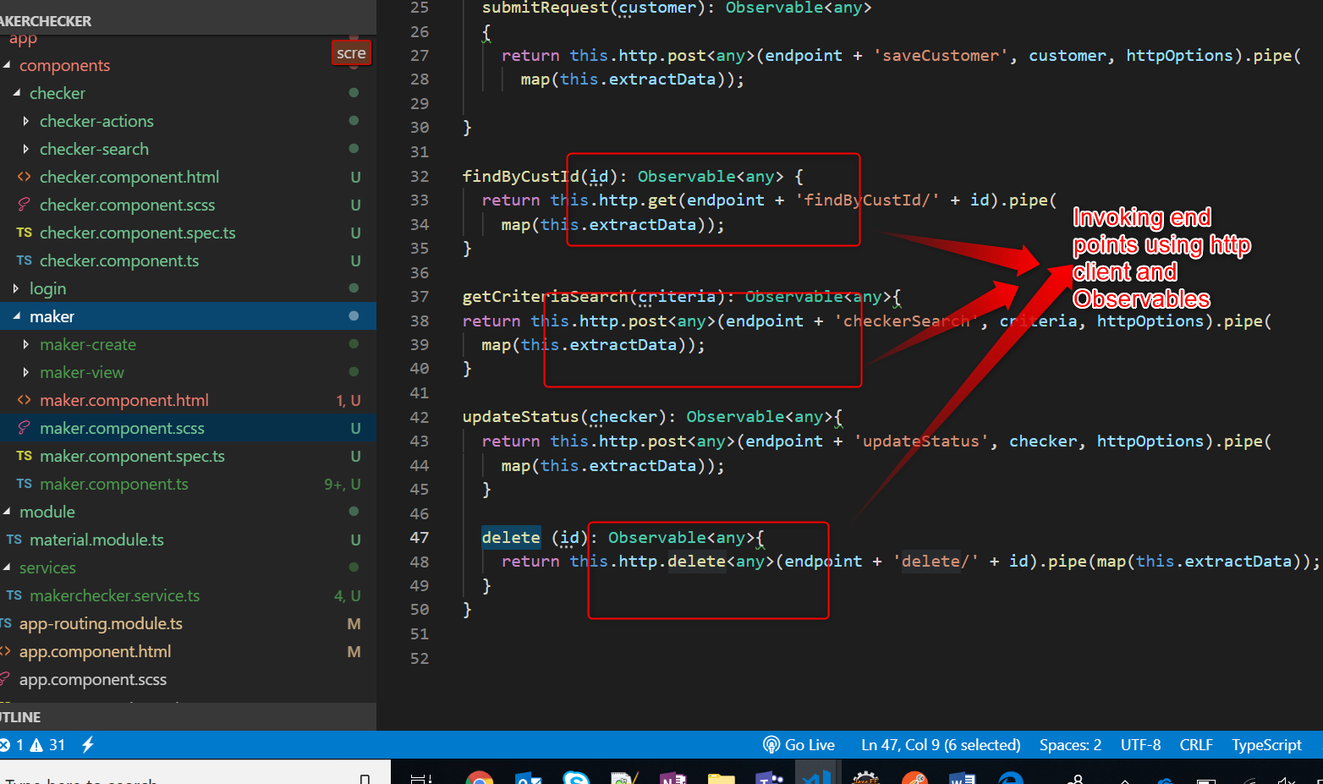
Code Snippets
Rest Endpoints

Slide 40
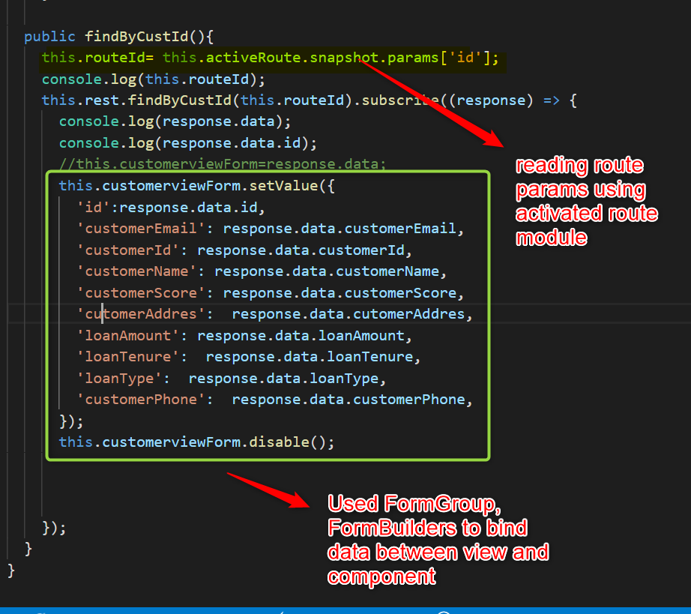
Code Snippets
Route Params

Slide 41
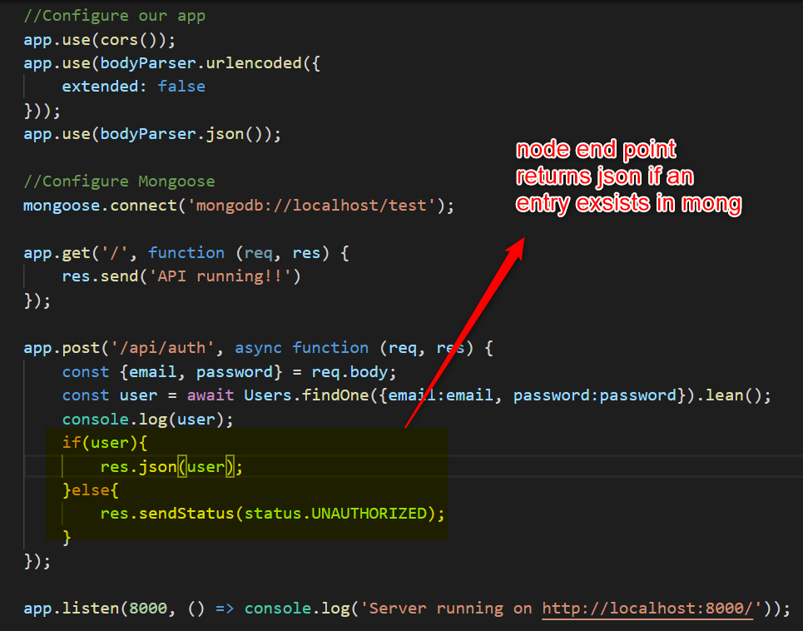
Code Snippets
Node Endpoint

Slide 42
Buglist
Angular table customisation is not working properly
Metadatasource module is not working as expected

Slide 43
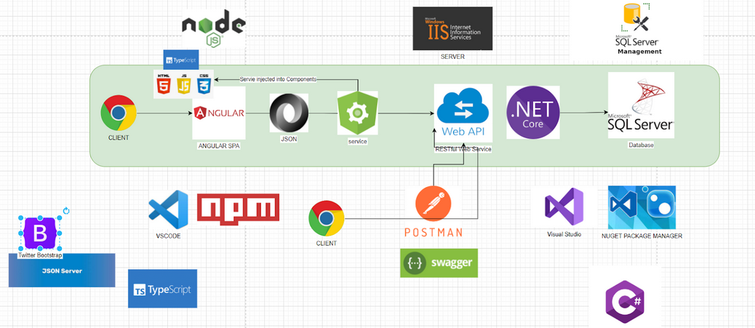
/PROJECT ARCHITECTURE OVERVIEW
INDEX.HTML

Slide 44
ENTITY RELATIONSHIP DIAGRAM

Slide 45


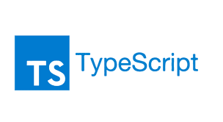




LANGUAGE && FRAMEWORKS

Slide 46

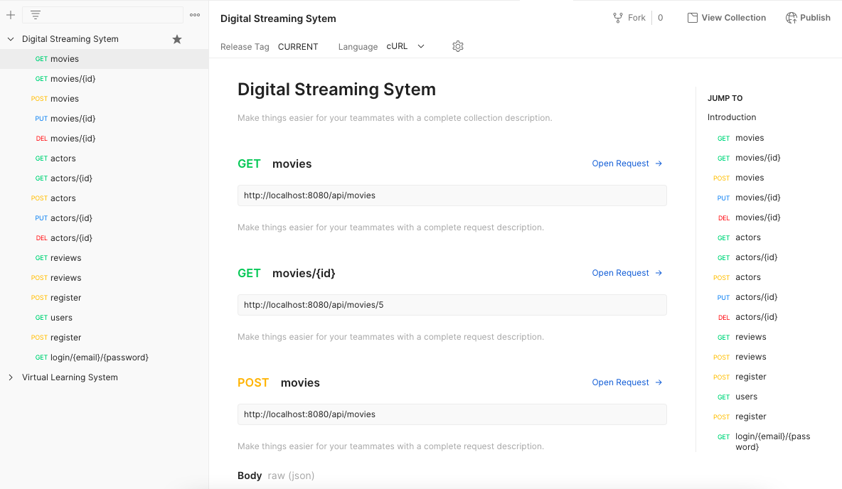
TESTING with Postman
routes | REST API

Slide 47
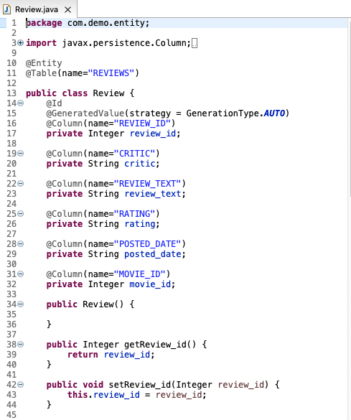
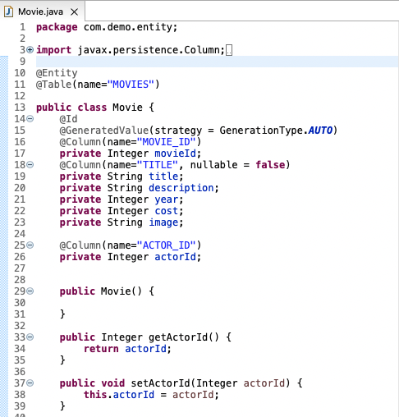
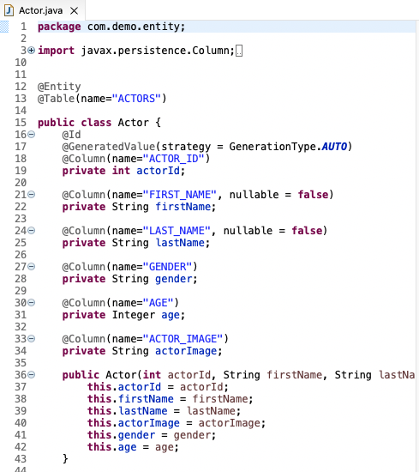
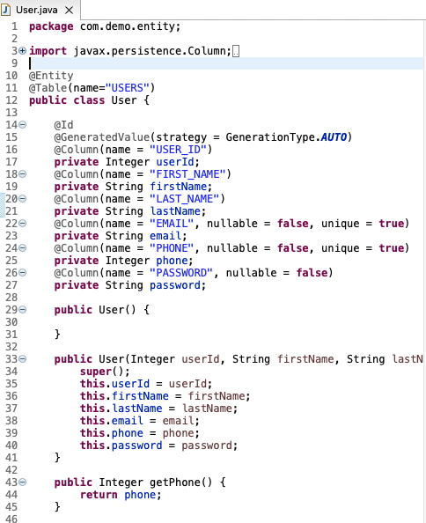
ENTITIES
backend | SRING BOOT

Slide 48
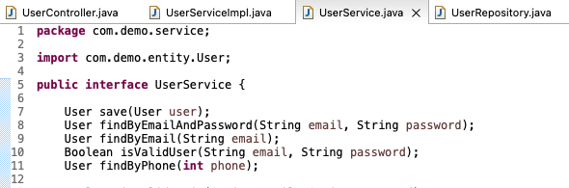
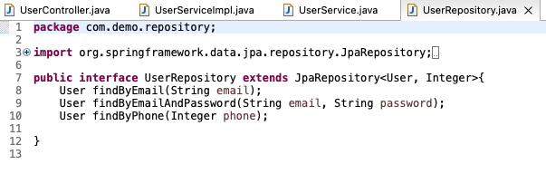
USER SERVICE && USER SERVICE IMPL
backend | SRING BOOT

Slide 49
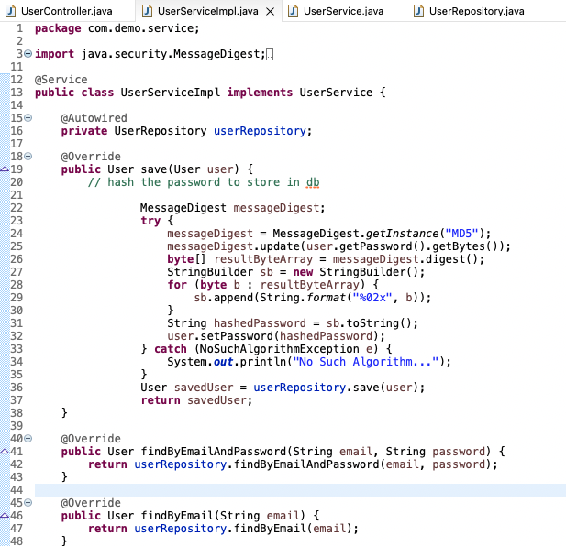
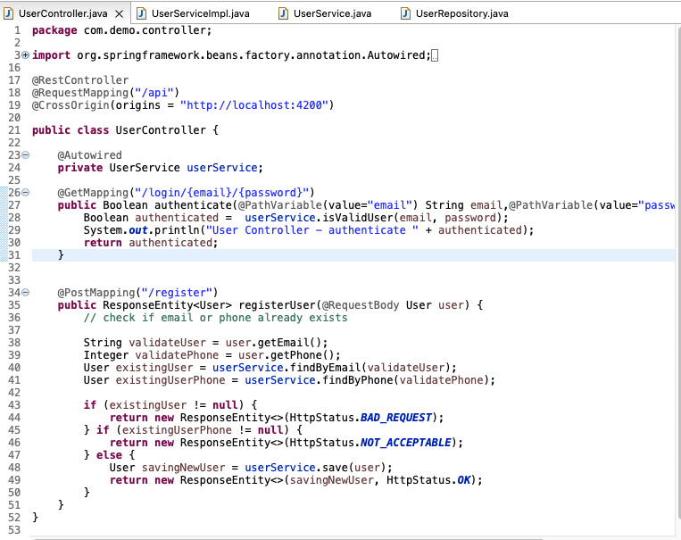
USER SERVICE && USER SERVICE IMPL
backend | SRING BOOT

Slide 50
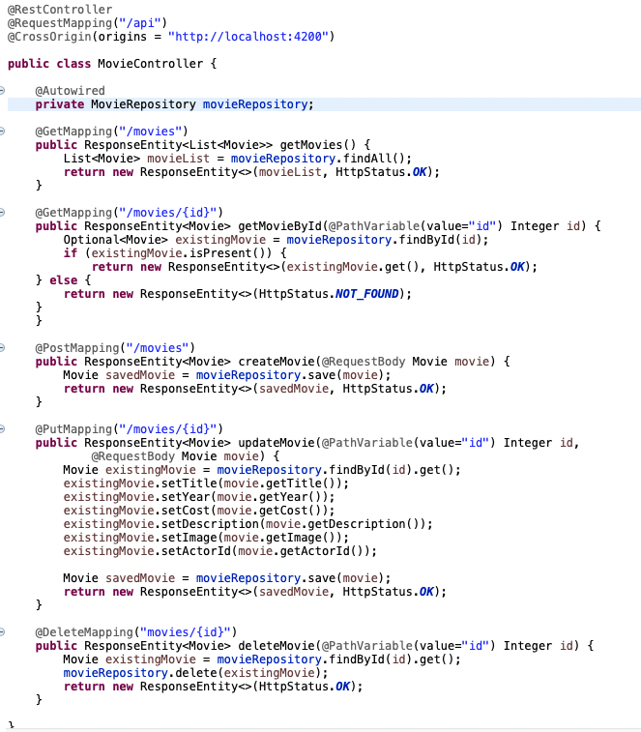
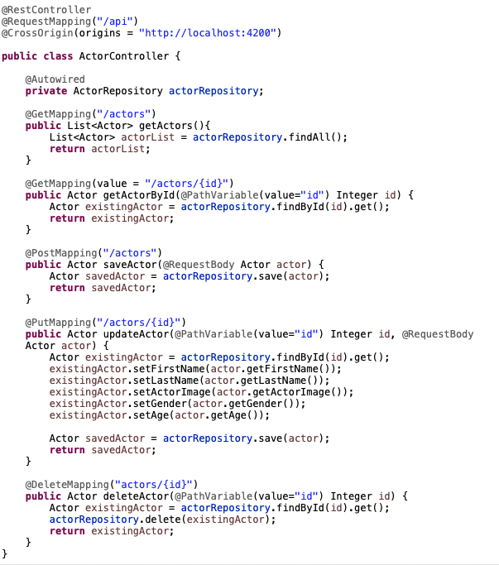
CONTROLLERS
backend | SRING BOOT

Slide 51
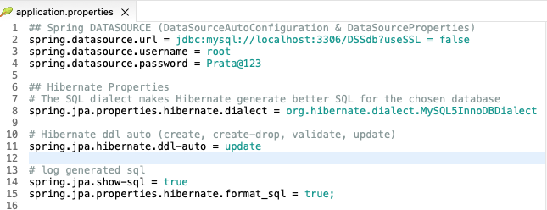
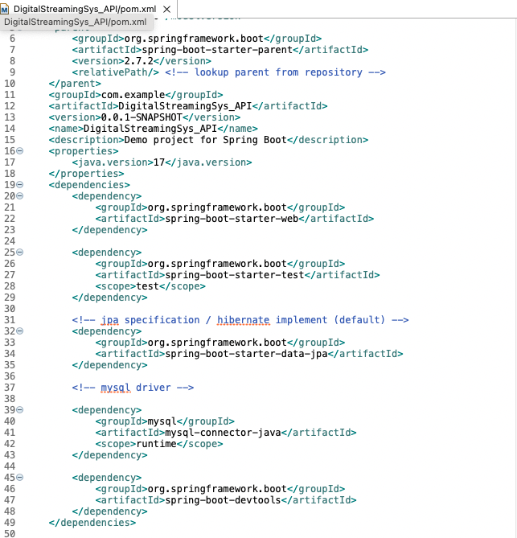
DEPENDENCIES && PROPERTIES
backend | SRING BOOT

Slide 52
Learnings
1
Angular Material Framework (most of the modules and validations)
2
Node
3
Mongo

Slide 53


